Slide 1
Project 0
Kenneth Bradburn
Timothy Yu

Slide 2

Live Demo

Slide 3
Menu Option for User Interface

Slide 4
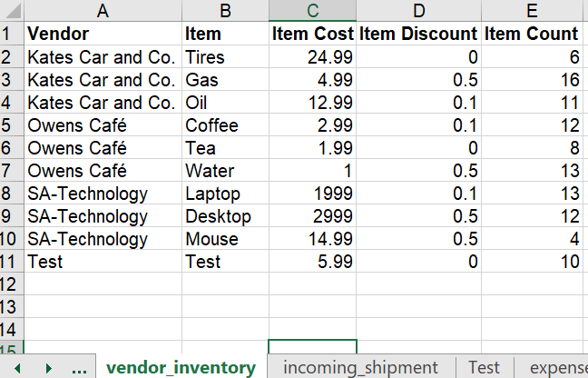
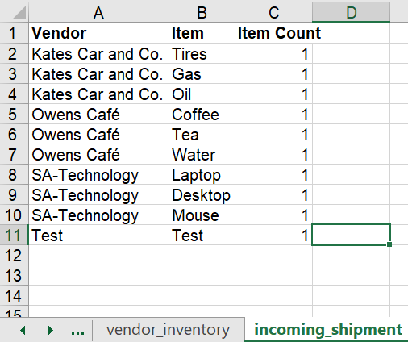
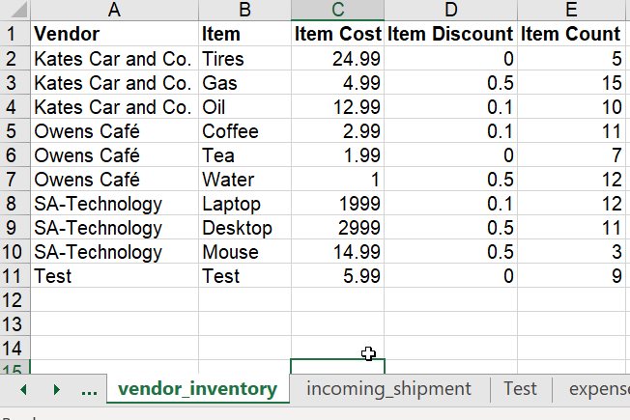
Stretch Goal: Update Inventory From Incoming Shipments

Slide 5

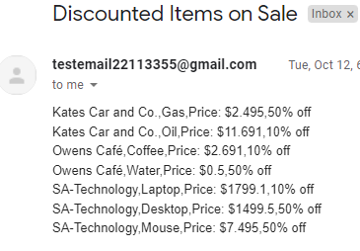
Stretch Goal: Email Client List Discounted Items

Slide 6
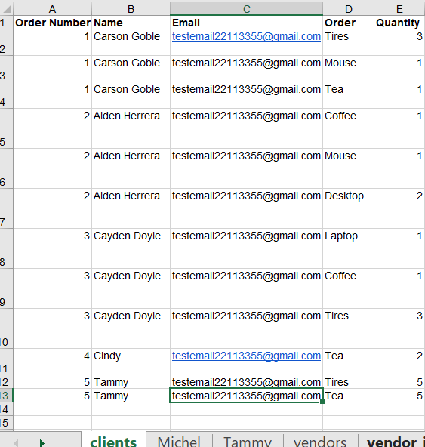
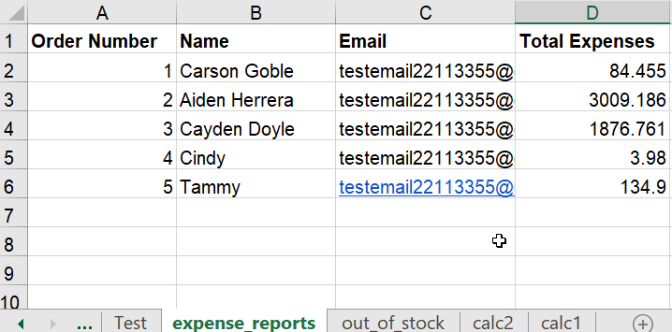
Feature: Total Expense Report

Slide 7

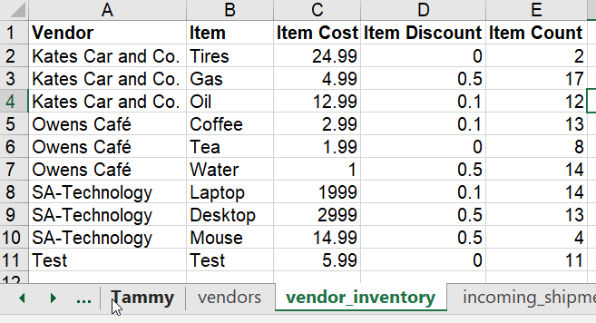

Feature: Out Of Stock

Slide 8
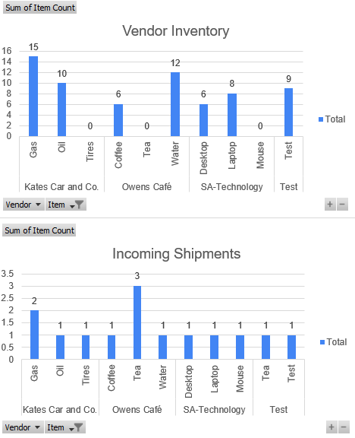
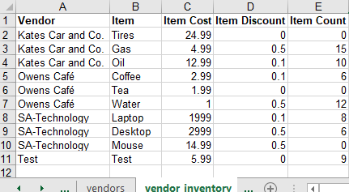
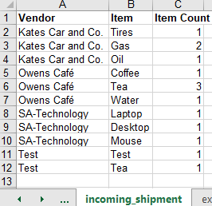
Feature: Automatic Updating Pivot Charts For Vendor Inventory And Incoming Shipments

